Slide 1
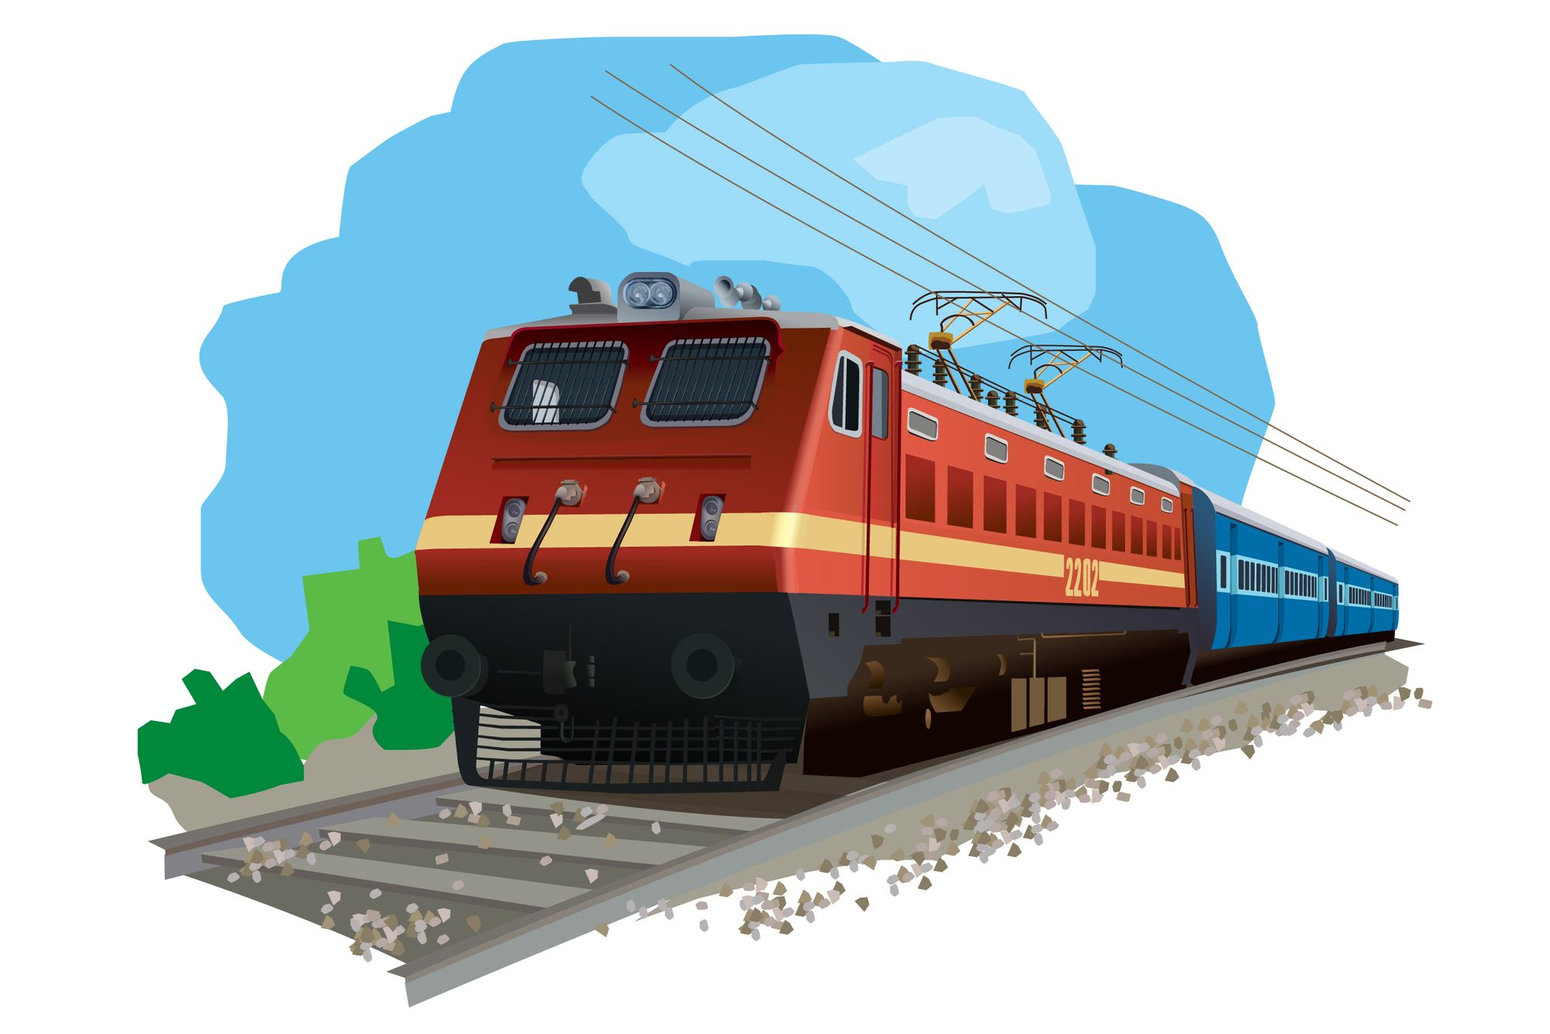
Indian Railways System Migration to
AWS

Slide 2
Topics :
Introduction to IRCTC
Current working of the Indian Railways System (IRS) platform
Why IRCTC is still using Private cloud (On-Premesis)
Consumption of Bandwidth, Storage and Processing of current IRS Platform
Process of Migrating the existing IRS Cloud to AWS
How AWS Services can be utilized to make IRS Platform fully functional.
Architecture Model for migrating IRS to the AWS
Pros and Cons of Migrating IRS to AWS

Slide 3
Introduction to IRCTC
We all have travelled in trains at least once in our lifetime, but many of us are not aware of its working and mechanics. The Indian Railways is considered the backbone of our economy because of the dependency on the services they provide and how various sectors of the country rely on it. India has the 3rd largest railway network worldwide. But we know very little about the working and unique information about Indian Railways. This article will focus on every aspect related to Indian Railways and try to disseminate full details.
Extensive Network
Online Ticket Booking
PNR Enquiry System
Train Schedule and Route Information
Seat Availability and Booking Trends

Slide 4
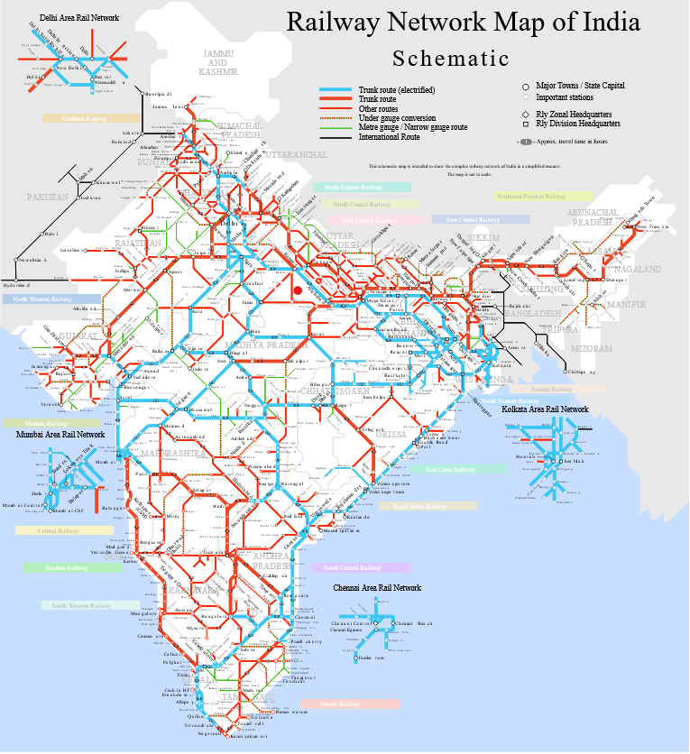
Extensive Network
The first feature, "Extensive Network," refers to the vast and well-developed railway infrastructure that the Indian Railways has established across the country. India has one of the largest and busiest railway networks globally, connecting various regions, states, cities, towns, and even remote areas. The extensive rail network facilitates the movement of passengers and freight, contributing significantly to the country's transportation system.

Slide 5
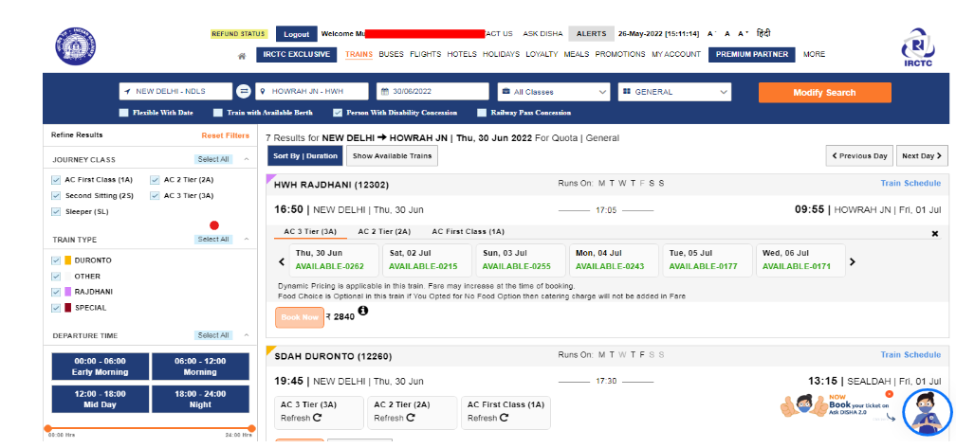
Online Ticket Booking
The second key feature, "Online Ticket Booking," reflects the modernization of Indian Railways through digital platforms. With the introduction of online ticketing systems like IRCTC, passengers can conveniently book their train tickets from the comfort of their homes using websites and mobile apps. This feature has not only simplified the reservation process but has also enhanced accessibility and efficiency for millions of travelers.

Slide 6
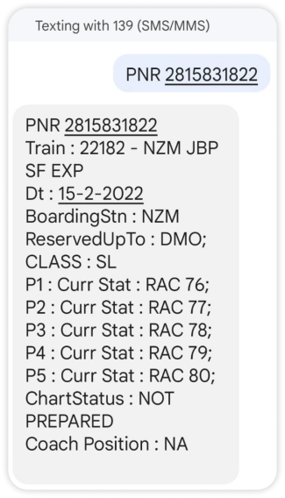
PNR Enquiry System
The Passenger Name Record (PNR) system is a key feature that allows passengers to check the status of their reservations, including seat assignments, coach details, and overall booking status.

Slide 7
Train Schedule and Route Information
provides users with concise and accurate details about the schedules and routes of trains operated by Indian Railways. Passengers can access real-time information on train timings, station halts, and the entire route of a particular train. This feature aids travelers in planning their journeys effectively, allowing them to make informed decisions about boarding and alighting at specific stations along the route. It enhances the overall travel experience by offering transparency and accessibility to essential scheduling and route details.
Diverse Travel Classes
Indian Railway System offers passengers a range of travel classes to choose from based on their preferences and budget. These classes include options like Sleeper Class, AC 3 Tier, AC 2 Tier, First Class, and more. Each class provides different levels of comfort, amenities, and pricing. This diversity allows passengers to select the class that best suits their travel needs, ensuring a personalized and flexible travel experience on Indian Railways.

Slide 8
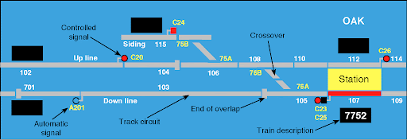
Current working of the Indian Railways System (IRS) platform
Signalling system
There are different types of signalling system which are used to manage the train operations. They are majorly classified based on traffic or safety. For a high-density route, automatic block signalling is used. Similarly, a manual block signalling system is used for a low-density route in which the physical exchange of tokens takes place. Absolute block signalling is used by signalmen from the signal boxes at the railway stations for the rest. The signals are interlocked using various methods to eliminate the scope of human error for signalling.

Slide 9
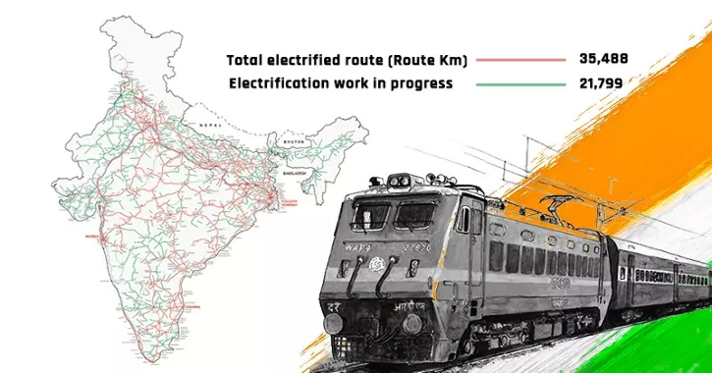
Electrification of railways
The electrification of the railway’s network is undertaken by The Central Organisation for Railway Electrification (CORE). It is planning to electrify all the routes by 2024. Today, nearly 58% of the route’s kilometres are electrified. It includes the electrification of both the lines and the conversion of the gauge. Electrification is done for the locomotives, the equipment used for maintenance, the network for power supply, signaling, and fibre-based communication systems.

Slide 10
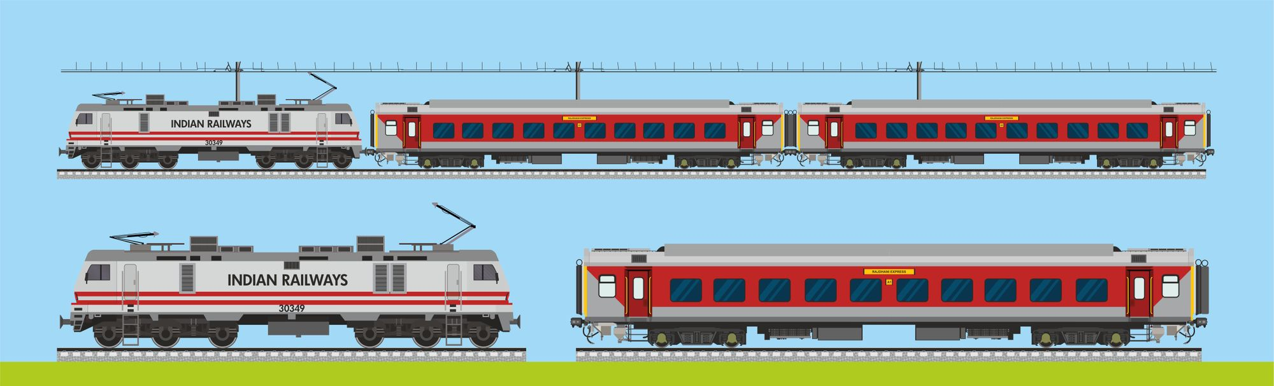
Train preparation
Before any journey starts, there is a protocol for how the train needs to be prepared. The coaches should be placed on the platform well in time to allow various pre-departure functions to be completed, including loading of mails, luggage, linen and parcels, watering, cleaning, pantry car provisions, cooling the AC coaches, displaying the reservation charts, attaching locomotives, and deploying the railway staff. Once all these functions are checked duly, the train is all-set for departure.

Slide 11
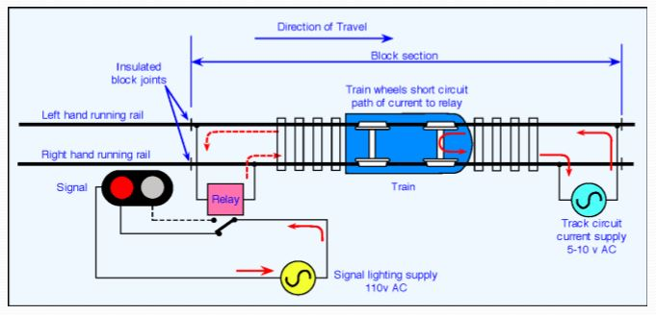
Track circuit
We all know that trains run on tracks; they were initially categorized based on the tracks’ size, which are the broad gauge, meter gauge, and narrow gauge. Now, we majorly have broad-gauged tracks. Indian railways have an approximate 1.23L km. of track length and 67,000 km. of route length. For the detection of trains, track circuiting is used. Axle counters can also be utilized for the same.

Slide 12
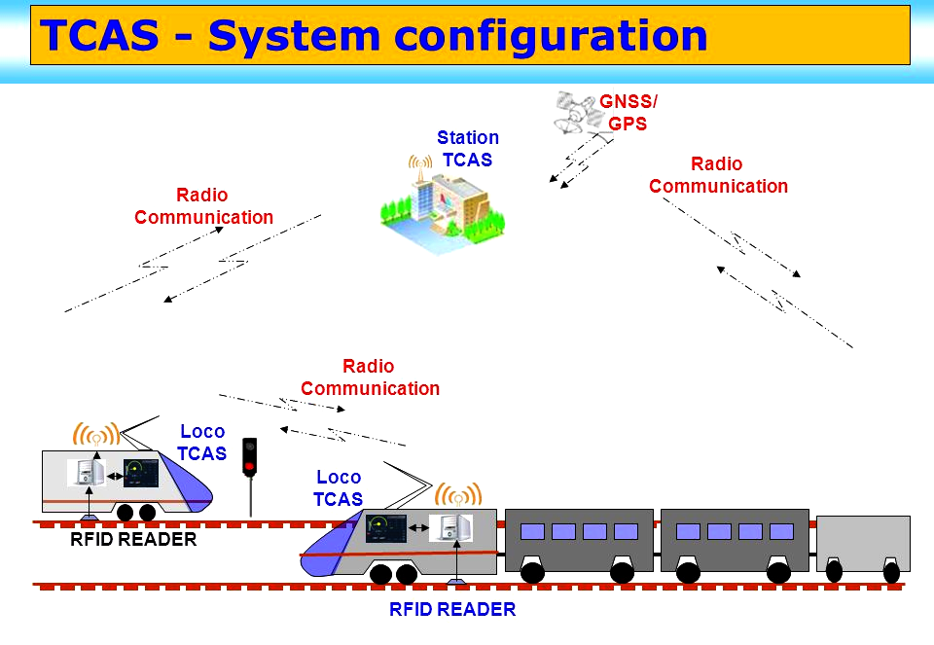
Technology is used in Indian Railways
Some of the key technologies being used by IRCTC to prevent accidents include Train Protection and Warning System (TPWS), Vehicular Anti-collision System (VACS), Vigilance Control Device (VCD), Train Collision Avoidance System (TCAS), Mobile Train Radio Communication (MTRC) System, and Train Management System (TMS).

Slide 13
Why IRCTC is still using Private cloud (On-Premesis)
Legacy Systems
Data Sensitivity and Compliance
Customization and Control
Predictable Costs
Performance and Latency
Vendor Lock-In Concerns
Hybrid Infrastructure Strategy
Investment in Existing Infrastructure

Slide 14
Consumption of Bandwidth, Storage and Proccessing of current IRS Platform
Bandwidth
User Access With millions of users accessing the platform daily, IRCTC would need a high-bandwidth connection to ensure fast and seamless access to its services. This involves not just serving web pages but also handling API requests, mobile app interactions, and more.
Multimedia Content IRCTC likely hosts images, videos, and other multimedia content related to train journeys, destinations, and services. A Content Delivery Network (CDN) may be employed to distribute this content efficiently and reduce latency for users across different geographical locations.
Transaction Data Since ticket booking involves real-time transactions, a secure and fast connection is crucial to ensure that users can complete their transactions without delays.

Slide 15
Storage
User Data IRCTC would store user data, including account information, booking history, and personal details. The storage infrastructure must be capable of handling a vast and growing user base.
Ticketing Information Storing details of millions of train journeys, seat availability, pricing information, and booking statuses requires a robust and scalable database system. This might involve the use of distributed databases for improved performance and reliability.
Redundancy and Backups To ensure data integrity and availability, IRCTC would implement redundant storage systems and regular backup procedures.
Processing
Real-time Transaction Processing The platform needs powerful servers and a high-performance database system to process ticket bookings in real-time. This includes handling payment transactions securely and efficiently.
Load Balancing To distribute incoming user requests evenly across multiple servers, load balancing mechanisms are likely implemented. This helps prevent server overloads during peak times, ensuring a smooth user experience.
Scalability The platform should be designed to scale horizontally, meaning it can add more servers to the system as the user base grows. This scalability ensures that the platform can handle increased demand without a significant decrease in performance.

Slide 16
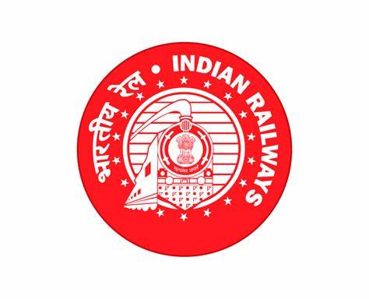
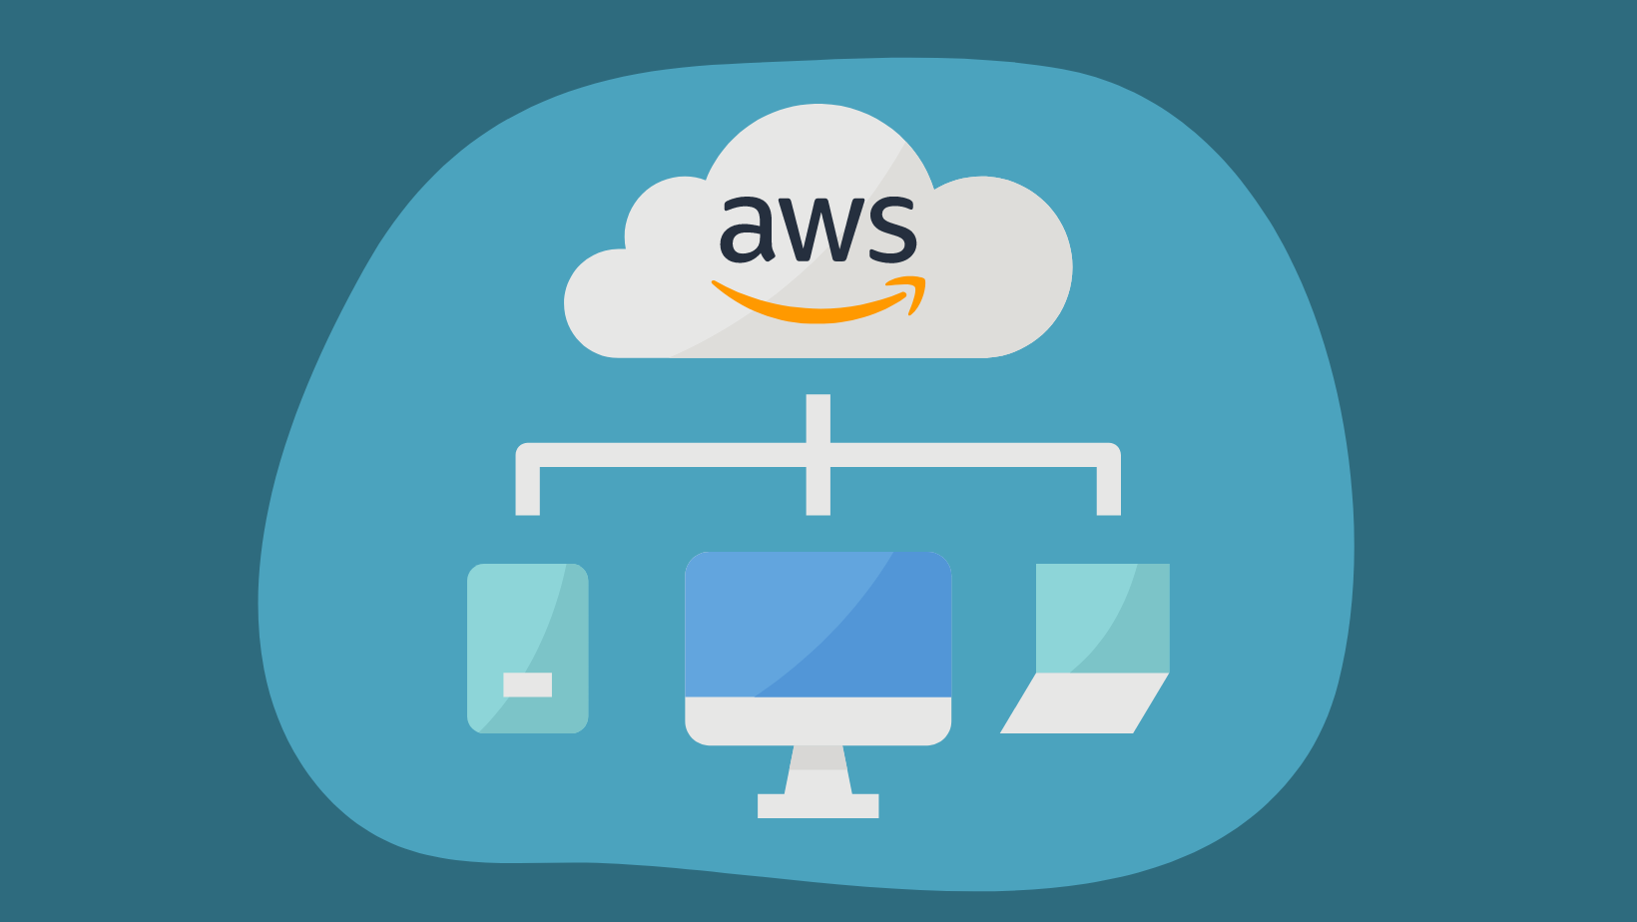
Process of Migrating the existing IRS Cloud to AWS

Slide 17
Migrating the existing Internal Revenue Service (IRS) infrastructure to Amazon Web Services (AWS) involves several steps, each of which requires careful planning, execution, and monitoring. Below is an outline of the process, including data migration, application reconfiguration, and potential challenges:
Assessment and Planning
Data Migration
Application Migration
Infrastructure Configuration
Testing and Validation

Slide 18
Assessment and Planning
Assess Current Infrastructure Evaluate the existing IRS infrastructure, including servers, databases, applications, and network architecture.
Define Migration Goals Determine the objectives of migrating to AWS, such as cost savings, scalability, security enhancements, and improved performance.
Select Migration Approach Choose the most suitable migration strategy, such as lift-and-shift (rehost), refactor, re-platform, or rebuild, based on the assessment of applications and workloads.
Rehost (“lift and shift”) Move applications to AWS without changes. In large-scale, legacy migrations, organizations are looking to move quickly to meet business objectives. Applications may become easier to re-architect once they are already running in the cloud. This happens because the hard part, which is migrating the application, data, and traffic, has already been accomplished.
Replatform (“lift, tinker and shift”). Replatforming Tools. Amazon Relational Database Service (RDS) for relational databases – AWS manages the database application for you, so you can focus on the application of the database itself . AWS Elastic Beanstalk – a fully managed platform where you can simply deploy your code, and AWS will handle scaling, load balancing, monitoring, database and compute provisioning for you

Slide 19
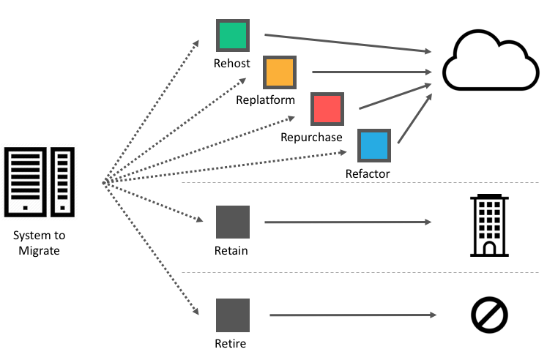
Repurchase (“drop and shop”) Move from perpetual licenses to a software-as-a-service model. For workloads that can easily be upgraded to newer versions, this strategy might allow a feature set upgrade and smoother implementation.
Refactor / Re-architect Re-imagine how the application is architected and developed using cloud-native features. Typically, this is driven by a strong business need to add features, scale, or performance that would otherwise be difficult to achieve in the application’s existing environment.
Retire Identify IT assets that are no longer useful and can be turned off. This will help boost your business case and direct your attention towards maintaining the resources that are widely used.
Retain portions of your IT portfolio if there are some applications that are not ready to be migrated and will produce more benefits when kept on-premises, or you are not ready to prioritize an application that was recently upgraded and then make changes to it again.

Slide 20
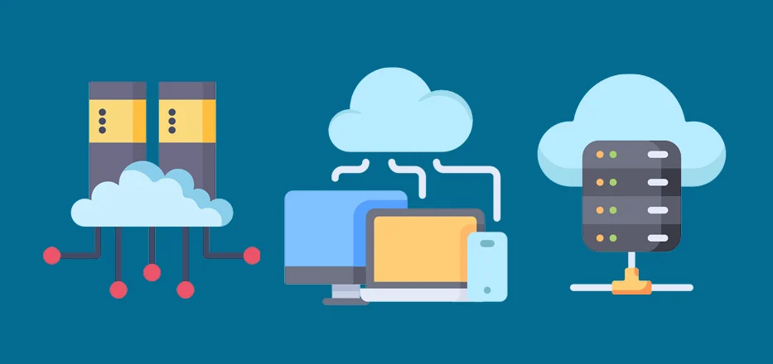
Data Migration
Data Inventory Identify all data sources and categorize them based on sensitivity, volume, and criticality.
Data Transfer Use AWS Data Migration Service (DMS) or Snowball to migrate databases, files, and other data to AWS storage solutions such as Amazon S3, RDS, or DynamoDB.
Data Validation Verify data integrity and consistency post-migration through validation tests and comparisons with source systems.

Slide 21
AWS Migration Hub Provides a single location to track the progress of application migrations across multiple AWS and partner solutions. Using Migration Hub allows you to choose the AWS and partner migration tools that best fit your needs, while providing visibility into the status of migrations across your portfolio of applications.
AWS Application Discovery Service Collects and presents configuration, usage, and behavior data from your servers to help you plan your migration.
AWS Server Migration Service (SMS) An agentless service for migrating thousands of on-premises workloads to AWS.
AWS Database Migration Service (DMS) Helps you migrate databases to AWS. The source database remains fully operational during the migration.
AWS Snowball A petabyte-scale data transport solution that uses secure appliances to transfer large amounts of data into and out of AWS.
AWS Snowmobile An exabyte-scale data transfer service used to move extremely large amounts of data to AWS.
AWS Direct Connect lets you establish a dedicated network connection line between your network and one of the AWS Direct Connect locations.
Amazon Kinesis Firehose A fully managed service for loading streaming data into AWS.

Slide 22
AWS Snow Family overview
Applications are moving to the cloud faster today than ever before. A new category of applications requires increased capabilities and performance at the edge of the cloud, or even beyond the edge of the network.
AWS provides edge infrastructure and software that moves data processing and analysis as close as necessary to where data is created in order to deliver intelligent, real-time responsiveness and streamline the amount of data transferred. This includes deploying AWS managed hardware and software to locations outside AWS Regions and even beyond AWS Outposts.
The AWS Snow Family helps customers that need to run operations in austere, non-data center environments, and in locations where there's lack of consistent network connectivity. The Snow Family, comprised of AWS Snowcone, AWS Snowball, and AWS Snowmobile, offers a number of physical devices and capacity points, most with built-in computing capabilities. These services help physically transport up to exabytes of data into and out of AWS. Snow Family devices are owned and managed by AWS and integrate with AWS security, monitoring, storage management, and computing capabilities.

Slide 23
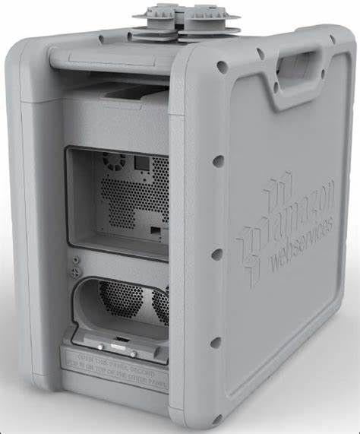
AWS Snowball
AWS Snowball is a data migration and edge computing device that comes in two device options:
Compute Optimized and Storage Optimized. Snowball Edge Storage Optimized devices provide 40 vCPUs of compute capacity coupled with 80 terabytes of usable block or Amazon S3-compatible object storage. It is well-suited for local storage and large-scale data transfer. Snowball Edge Compute Optimized devices provide 52 vCPUs, 42 terabytes of usable block or object storage, and an optional GPU for use cases such as advanced machine learning and full motion video analysis in disconnected environments. Customers can use these two options for data collection, machine learning and processing, and storage in environments with intermittent connectivity (such as manufacturing, industrial, and transportation) or in extremely remote locations (such as military or maritime operations) before shipping it back to AWS. These devices may also be rack mounted and clustered together to build larger, temporary installations.

Slide 24
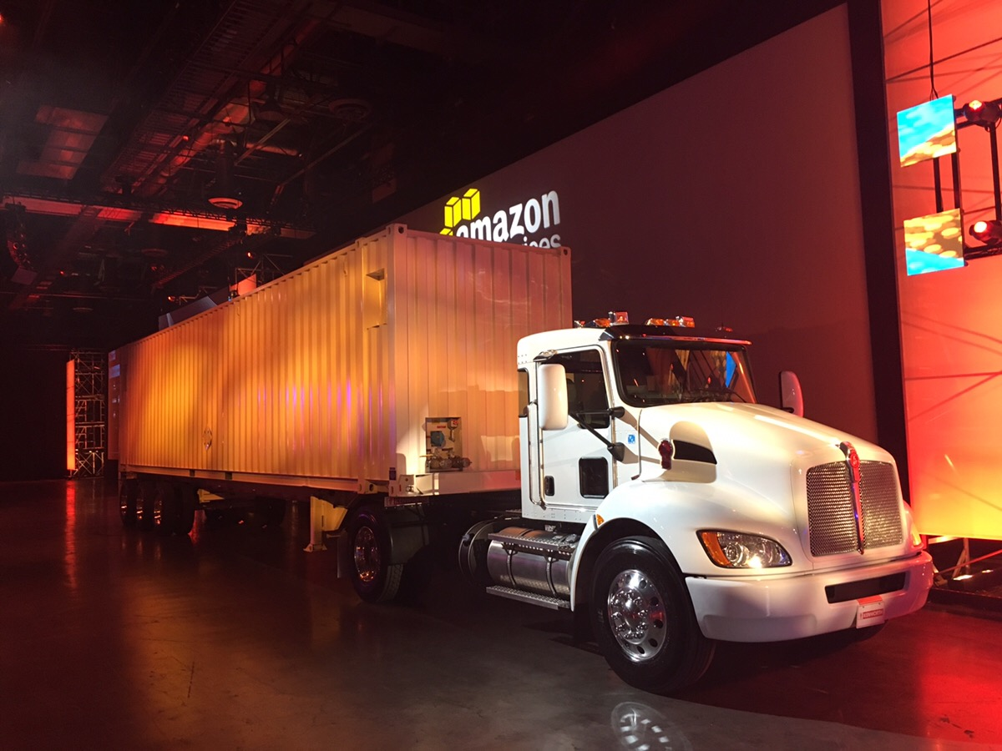
AWS Snowmobile
AWS Snowmobile moves up to 100 PB of data in a 45-foot long ruggedized shipping container and is ideal for multi-petabyte or Exabyte-scale digital media migrations and data center shutdowns. A Snowmobile arrives at the customer site and appears as a network-attached data store for more secure, high-speed data transfer. After data is transferred to Snowmobile, it is driven back to an AWS Region where the data is loaded into Amazon S3.
Snowmobile is tamper-resistant, waterproof, and temperature controlled with multiple layers of logical and physical security -- including encryption, fire suppression, dedicated security personnel, GPS tracking, alarm monitoring, 24/7 video surveillance, and an escort security vehicle during transit.

Slide 25
Application Migration
Application Inventory Create an inventory of all applications hosted on the existing infrastructure, including dependencies and integration points.
Identify Applications Create an inventory of all IRS applications, including their dependencies, architecture, and usage patterns.
Categorize Applications Classify applications based on their criticality, complexity, and compatibility with cloud environments.
Assess Migration Feasibility Evaluate each application for its suitability for migration to AWS, considering factors such as technology stack, data dependencies, and regulatory compliance.
Rehosting (Lift-and-Shift) Use AWS SMS or third-party tools to replicate on-premises servers to EC2 instances.
Replatforming Modify application configurations and deploy on AWS managed services (e.g., RDS, ECS, Lambda).
Refactoring Rewrite or redesign applications for cloud-native architectures (e.g., microservices, serverless).

Slide 26
Infrastructure Configuration
Network Setup Configure Virtual Private Cloud (VPC), subnets, route tables, security groups, and network access control lists (ACLs) to replicate existing network architecture on AWS.
Identity and Access Management (IAM) Define IAM roles, policies, and permissions to manage access to AWS resources securely.
Monitoring and Logging Set up CloudWatch for monitoring application performance, resource utilization, and security compliance, and configure CloudTrail for logging and auditing AWS API activity.
Multi-Factor Authentication (MFA) Enable MFA for IAM users and roles to add an additional layer of authentication and enhance security.
Cross-Account Access Implement cross-account IAM roles to facilitate secure access between AWS accounts and services within the IRS organization.
Amazon EC2: Launch EC2 instances to host IRS applications and workloads, selecting instance types, sizes, and configurations based on performance and resource requirements.
Auto Scaling: Implement auto-scaling groups to automatically adjust the number of EC2 instances based on demand, optimizing resource utilization and ensuring high availability.
Amazon EC2: Launch EC2 instances to host IRS applications and workloads, selecting instance types, sizes, and configurations based on performance and resource requirements.
Auto Scaling: Implement auto-scaling groups to automatically adjust the number of EC2 instances based on demand, optimizing resource utilization and ensuring high availability.

Slide 27
Testing and Validation
Functional Testing Conduct functional testing of migrated applications to ensure proper functionality and compatibility with AWS environment.
Performance Testing Measure application performance metrics such as response time, throughput, and scalability under varying loads.
Security and Compliance Testing Validate security controls, encryption mechanisms, and compliance requirements to ensure data protection and regulatory compliance.
During the testing and validation phase of migrating the IRS infrastructure to Amazon Web Services (AWS), various AWS services are utilized to ensure a smooth transition and verify the functionality, performance, security, and compliance of the migrated components. Here are the AWS services commonly used for testing and validation during migration:
AWS CloudEndure Migration
AWS CloudEndure provides automated replication and continuous testing of on-premises servers to AWS.
Continuous data replication, automated machine conversion, and testing of migrated servers in the AWS cloud.
Continuous testing of migrated servers for functionality, performance, and compatibility with AWS environment.

Slide 28
AWS Database Migration Service (DMS)
DMS enables the migration of databases to AWS, ensuring minimal downtime and data loss.
Homogeneous and heterogeneous database migration, schema conversion, and ongoing replication.
Testing the migration of databases to AWS, validating data integrity, and ensuring compatibility with AWS database services.
AWS Server Migration Service (SMS)
SMS automates the migration of on-premises virtual machines (VMs) to AWS EC2 instances.
Server discovery, automated replication, and incremental replication for continuous testing.
Testing the migration of VMs to AWS, validating application functionality, and performance in the cloud environment.
AWS CloudFormation
CloudFormation provides infrastructure as code (IaC) capabilities for automating the provisioning of AWS resources.
Template-based provisioning, automated resource management, and stack management.
Automating the deployment of test environments, infrastructure validation, and configuration management during migration testing.

Slide 29
Potential Challenges
Complexity of Legacy Systems Legacy systems within the IRS may have intricate architectures, dependencies, and custom configurations, making them challenging to migrate seamlessly to AWS.
Data Migration Complexity Transferring large volumes of sensitive data while minimizing downtime and ensuring data integrity can be complex and time-consuming, especially for mission-critical systems.
Application Compatibility Ensuring that IRS applications are compatible with AWS services and cloud-native architectures may require modifications, refactoring, or re-engineering to function optimally in the cloud environment.
Performance Optimization Optimizing application performance and scalability in the AWS environment may require fine-tuning configurations, monitoring performance metrics, and implementing scaling strategies to meet user demands.
Resource Optimization Balancing performance requirements with cost considerations in the cloud requires ongoing optimization efforts to ensure efficient resource utilization and cost-effectiveness.
Skills and Training Acquiring the necessary skills and expertise in AWS technologies and best practices among IRS personnel may pose a challenge and require investment in training and upskilling initiatives.

Slide 30
How AWS Services can be utilized to make IRS Platform fully functional.
Amazon EC2 Amazon Elastic Compute Cloud (EC2) provides scalable compute capacity in the cloud. You can launch virtual servers (instances) in the AWS cloud to run applications, host websites, or perform compute-intensive tasks during migration and beyond
Amazon S3 Amazon Simple Storage Service (S3) offers scalable object storage in the cloud. You can use S3 to store data, backups, and archives during migration and ongoing operations
Amazon RDS Amazon Relational Database Service (RDS) offers managed database services for popular database engines like MySQL, PostgreSQL, SQL Server, Oracle, and others. You can migrate your on-premises databases to RDS for easier management, scalability, and high availability.
Amazon Elasticache Amazon Elasticache provides a fast in-memory data store for use as a database, cache, message broker, and queue. It stores ephemeral data in memory and gives a sub-millisecond response.Elasticache is used in real-time transactions, chat, BI and analytics, session store, gaming leaderboards, and cache.

Slide 31
Amazon DynamoDB Amazon DynamoDB is a serverless, NoSQL database service that enables you to develop modern applications at any scale. As a serverless database, you only pay for what you use and DynamoDB scales to zero, has no cold starts, no version upgrades, no maintenance windows, no patching, and no downtime maintenance. DynamoDB offers a broad set of security controls and compliance standards.

Slide 32
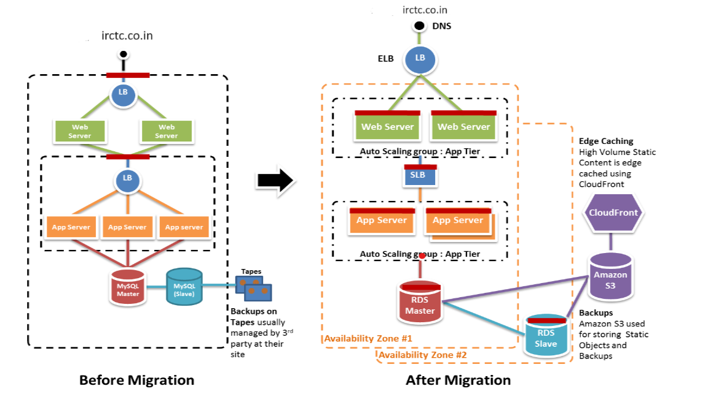
Architecture Model for migrating IRS to the AWS

Slide 33
Evaluation and Architecture Model for Migrating IRS to AWS
Considering the complexity and scale of the Indian Railways System (IRS), a microservices-based architecture deployed on AWS's serverless infrastructure would be the most appropriate choice for migrating IRS to AWS. By breaking down the IRS into smaller, decoupled services, it becomes easier to manage, scale, and maintain, while also improving fault tolerance and security. As AWS provides a wide range of services and tools that support the development and deployment of microservices also makes it a more suitable platform for this architecture model. This choice is best justified based on the following factors:
Scalability
Microservices architecture allows for independent scaling of individual components or services based on demand. This would be beneficial for IRS, as it can handle varying levels of traffic and workload more effectively. For example, services related to ticket booking, train tracking, and passenger information can scale independently based on usage patterns.
Availability
Microservices architecture promotes fault isolation, meaning that failures in one service do not necessarily impact the entire system. This increases the overall availability of the IRS platform. Additionally, AWS provides built-in services such as Elastic Load Balancing and Auto Scaling that enhance fault tolerance and ensure high availability of microservices.

Slide 34
Security
Microservices architecture allows for fine-grained access control and security measures to be implemented at the service level.AWS offers a wide range of security services and features such as AWS Identity and Access Management (IAM), AWS Key Management Service (KMS), and AWS WAF (Web Application Firewall) to further strengthen security.
Cost Efficiency
Microservices architecture enables cost optimization by allowing resources to be provisioned and scaled independently based on usage patterns. This prevents over-provisioning of resources and ensures that only the necessary resources are utilized, leading to cost savings. Additionally, AWS offers pricing models such as pay-as-you-go and reserved instances that align with the usage patterns of microservices.
Technology Diversity
Microservices architecture allows for the use of diverse technologies and programming languages for different services. This flexibility enables IRS to leverage the most appropriate technology stack for each service, optimizing performance and development productivity.
Flexibility and Agility
Microservices architecture on AWS allows for greater flexibility and agility in development and deployment. Each microservice can be developed, tested, and deployed independently, enabling faster time-to-market and iterative development. AWS's managed services and DevOps tools such as AWS CodePipeline and AWS CodeDeploy further streamline the deployment process and enable continuous integration and delivery (CI/CD).

Slide 35
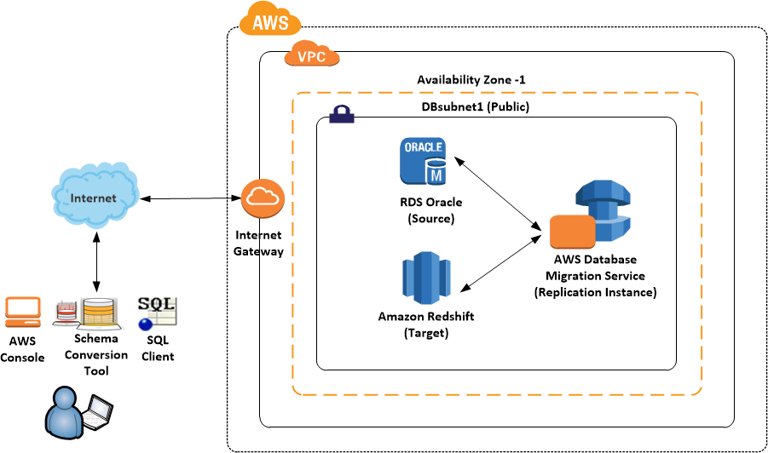
Fault Isolation
In a microservices architecture, failures in one service do not impact the entire system, as services are decoupled and isolated from each other. This enhances the reliability and resilience of the IRS platform, reducing the risk of widespread outages or disruptions.
Cloud-Native Capabilities
Microservices architecture aligns well with cloud-native principles and practices, making it easier to take advantage of AWS cloud services such as AWS Lambda, Amazon ECS (Elastic Container Service), and Amazon EKS (Elastic Kubernetes Service).

Slide 36
Pros and Cons of Migrating IRS to AWS
Before Migration
After Migration to AWS
Pros Legacy Infrastructure: Utilizing existing on-premises infrastructure may have provided a sense of control and familiarity to the IT team. Data Sovereignty: With data stored locally, there may have been fewer concerns regarding data sovereignty and compliance regulations.
Cons Scalability: Limited scalability may have hindered the ability to handle sudden spikes in demand, especially during peak travel times. Maintenance Overhead: Managing and maintaining physical servers can be time-consuming and resource-intensive. High Capital Expenditure: Initial setup costs and ongoing maintenance expenses for hardware and infrastructure can be significant.
Pros Scalability and Flexibility: AWS provides scalable resources, allowing the Indian Railway system to easily handle fluctuating demand. Cost-Efficiency: AWS offers a pay-as-you-go pricing model, reducing upfront costs and allowing for more efficient resource utilization. Reliability: AWS's global infrastructure and redundancy features can enhance the reliability and availability of railway services.
Cons Learning Curve: Transitioning to AWS may require training for IT staff to familiarize themselves with cloud concepts and AWS services. Data Transfer Costs: Depending on the volume of data transferred, there may be additional costs associated with data transfer to and from AWS. Potential Security Concerns: While AWS provides robust security features, misconfigurations or inadequate security measures could pose risks to data security.

Slide 37
IRS Sitemap
https://www.cloudinfinity.in/irctc-sitemap/

